Slide 1
Weekend March 21 & 22

Slide 2
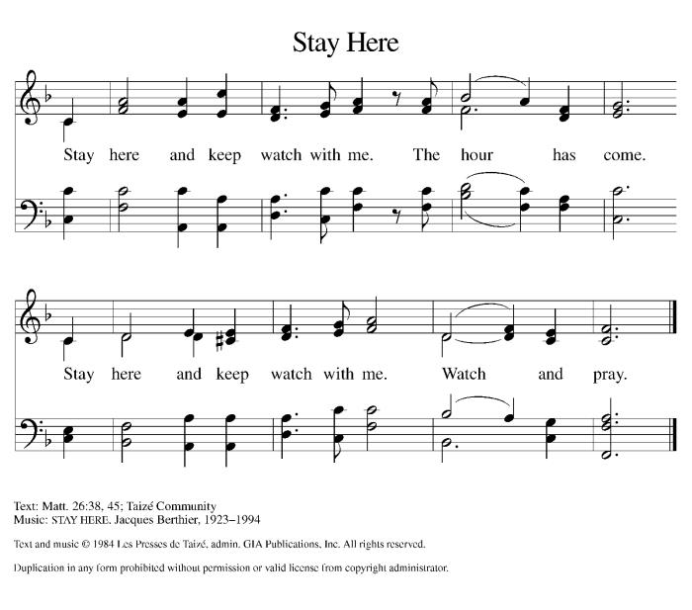
WOV # 667

Slide 4
ELW #715

Slide 6
ELW #715

Slide 8
3. Longing for food, many are hungry.
Longing for water, many still thirst.
Make us your bread, broken for others,
shared until all are fed.
Christ be our light!
Shine in our hearts.
Shine through the darkness.
Christ be our light!
Shine in Your Church gathered today.

Slide 9
4. Longing for shelter, many are homeless.
Longing for warmth, many are cold.
Make us your building, sheltering others,
walls made of living stone.
Christ be our light!
Shine in our hearts.
Shine through the darkness.
Christ be our light!
Shine in Your Church gathered today.

Slide 10
5. Many the gifts, many the people,
Many the hearts that yearn to belong.
Let us be servants to one another,
signs of Your kingdom come.
Christ be our light!
Shine in our hearts.
Shine through the darkness.
Christ be our light!
Shine in Your Church gathered today.

Slide 12
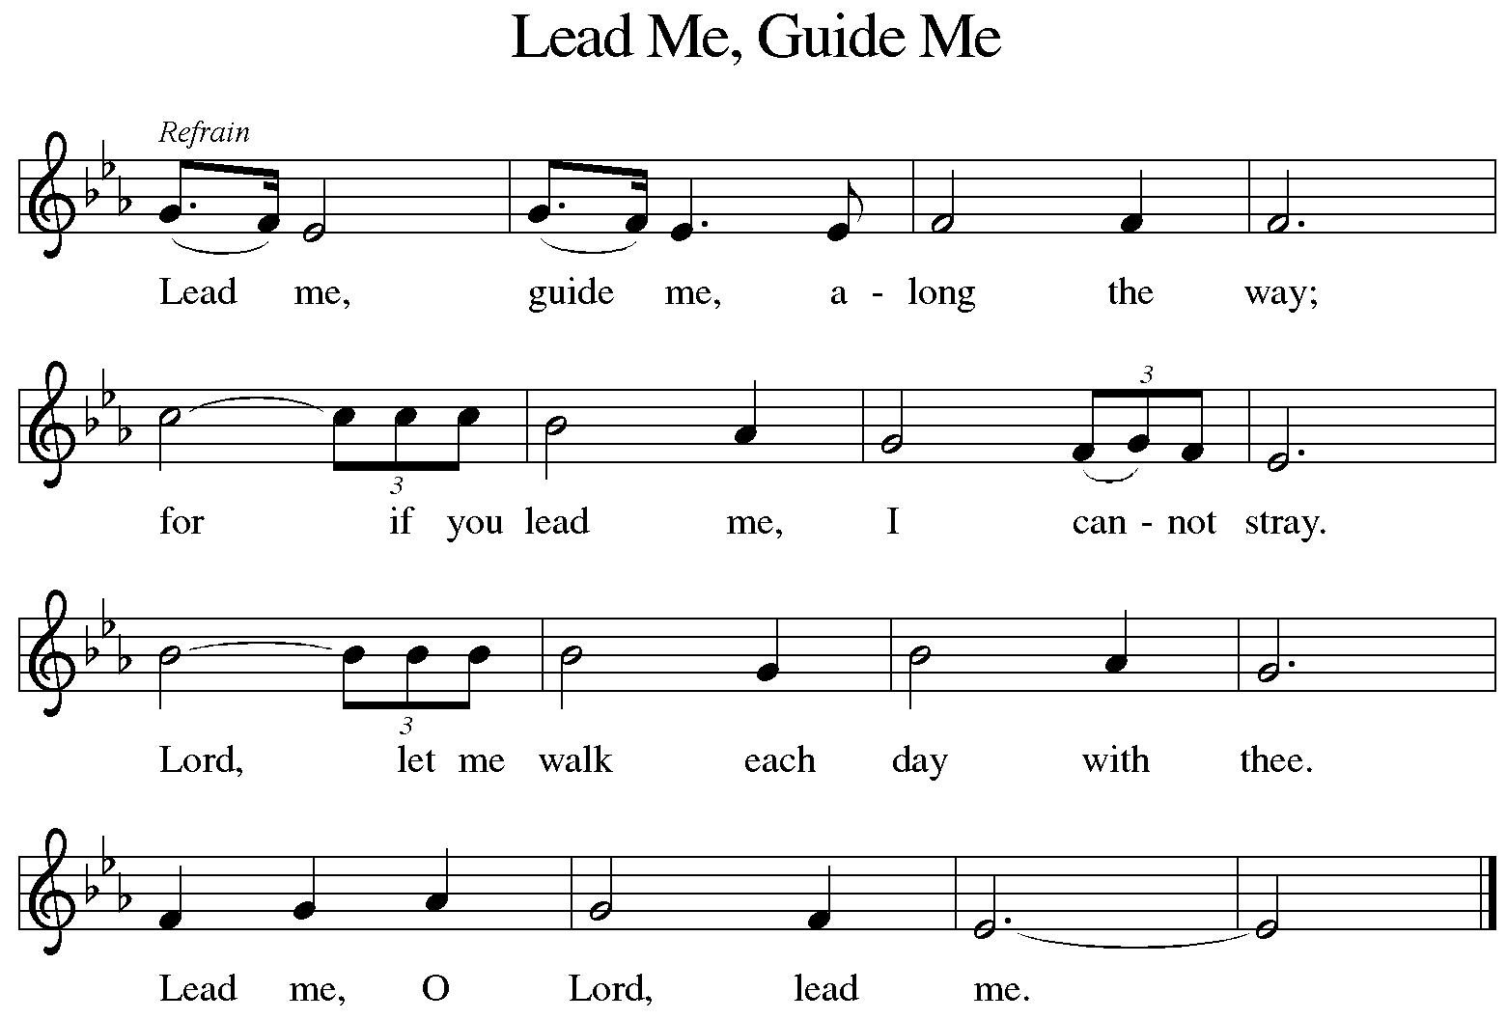
ELW #768

Slide 13
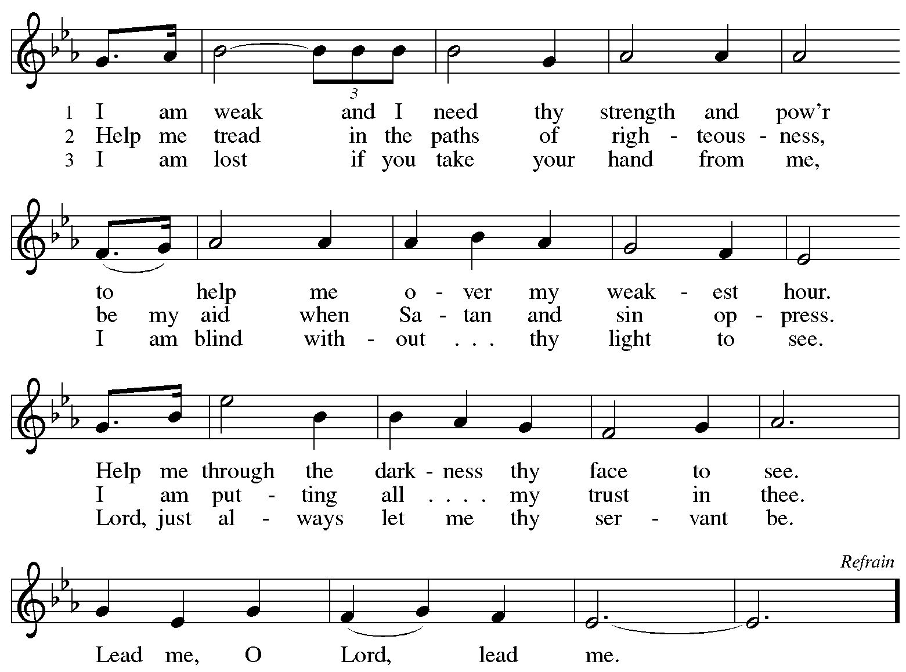

Slide 14
ELW #768

Slide 16
ELW #768

Slide 18
ELW #768

Slide 20
ELW #779

Slide 21
4 The Lord has promised good to me;
his word my hope secures;
he will my shield and portion be
as long as life endures.
5 When we've been there ten thousand years,
bright shining as the sun,
we've no less days to sing God's praise
than when we'd first begun.
Text: John Newton, 1725-1807, alt., sts. 1-4; anonymous, st. 5

Slide 23
ELW #452

Slide 25
Weekend March 28 & 29

Slide 26
WOV # 667

Slide 28
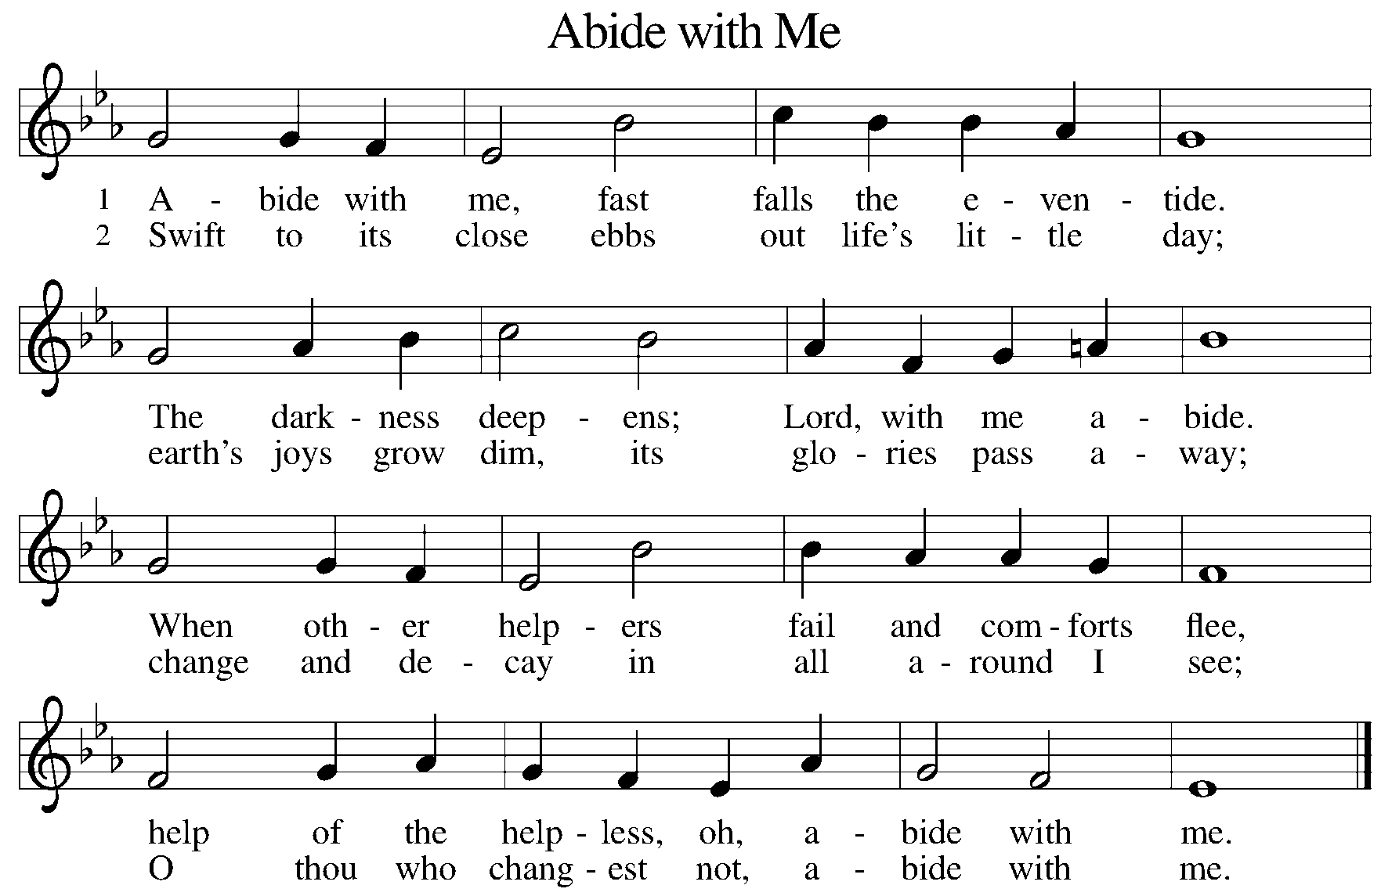
ELW #629

Slide 29
3 I need thy presence ev'ry passing hour;
what but thy grace can foil the tempter's pow'r?
Who like thyself my guide and stay can be?
Through cloud and sunshine, oh, abide with me.
4 I fear no foe, with thee at hand to bless;
ills have no weight, and tears no bitterness.
Where is death's sting? Where, grave, thy victory?
I triumph still, if thou abide with me!

Slide 30
5 Hold thou thy cross before my closing eyes,
shine through the gloom, and point me to the skies;
heav'n's morning breaks,
and earth's vain shadows flee;
in life, in death, O Lord, abide with me.
Text: Henry F. Lyte, 1793-1847

Slide 32
ELW #666

Slide 33
3 To God and to the Lamb I will sing, I will sing;
to God and to the Lamb I will sing;
to God and to the Lamb,
who is the great I Am,
while millions join the theme, I will sing, I will sing,
while millions join the theme, I will sing.
4 And when from death I’m free, I’ll sing on, I’ll sing on;
and when from death I’m free, I’ll sing on;
and when from death I’m free, I’ll sing God’s love for me,
and through eternity I’ll sing on, I’ll sing on;
and through eternity I’ll sing on.
Text: American folk hymn, alt.

Slide 35
ELW #673

Slide 37
ELW #595

Slide 39
ELW #614

Slide 41
ELW #617

Slide 42
ELW #617

Slide 43
ELW #617

Slide 44
ELW #617

Slide 45
ELW #617

Slide 47
Weekend April 4 & 5

Slide 48
Palm Sunday
Planning sheets say the hymns are already selected??

Slide 50
April 9 - Mandy Thursday

Slide 51
ELW #358

Slide 52
ELW #358

Slide 53
ELW #358

Slide 54
ELW #358

Slide 55
ELW #358

Slide 57
ELW #445

Slide 58
ELW #445

Slide 59
ELW #445

Slide 61
WOV #664

Slide 63
ELW #468

Slide 64
3 We are your own forever;
until our final breath
we will be true and never
in joy, in grief, in death
depart from you, for you are still
among your people dwelling,
as you have said you will.
Text: Frans Mikael Franzén, 1772-1847; tr. composite
Text © 1978 Lutheran Book of Worship, admin. Augsburg Fortress.

Slide 66
ELW #708

Slide 68
ELW #451

Slide 69
3 Glory be to God the Father,
glory be to Christ the Son,
glory to the Holy Spirit,
ever three and ever one;
as it was in the beginning,
glory now resounds again
in a song that has no ending. Amen
Text: John C. Ylvisaker Text © 1985 John C. Ylvisaker

Slide 71
Weekend April 11 & 12

Slide 72
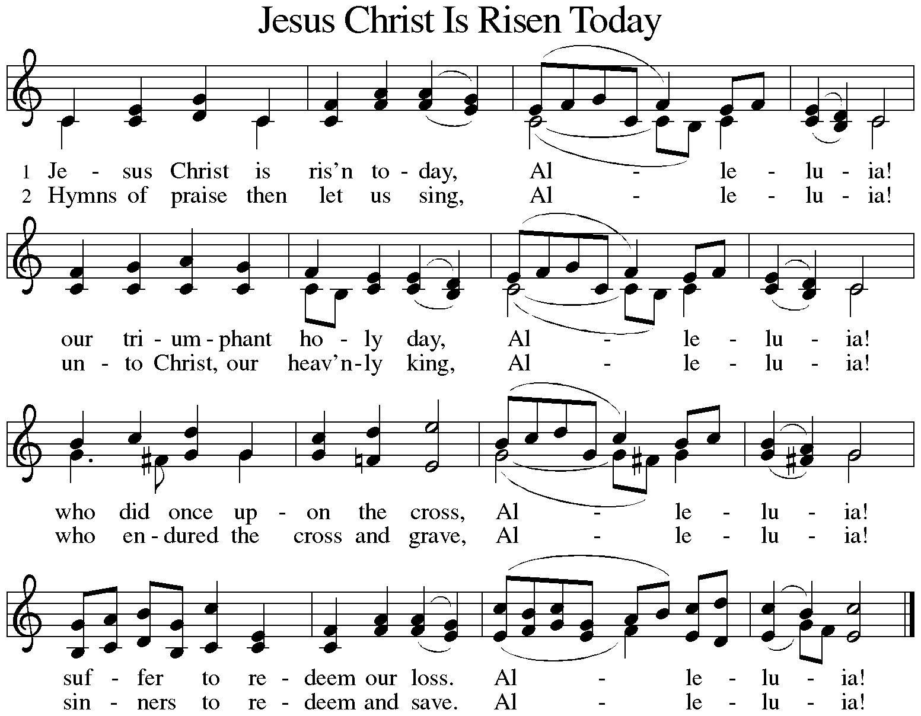
ELW #365

Slide 73
3 But the pains which he endured, Alleluia!
our salvation have procured; Alleluia!
now above the sky he's king, Alleluia!
where the angels ever sing. Alleluia!
4 Sing we to our God above, Alleluia!
praise eternal as his love; Alleluia!
praise him, all you heav'nly host, Alleluia!
Father, Son, and Holy Ghost. Alleluia!
Text: Latin carol, 14th cent., sts. 1-3; tr. J. Walsh, Lyra Davidica, 1708, alt.; Charles Wesley, 1707-1788, st. 4

Slide 75
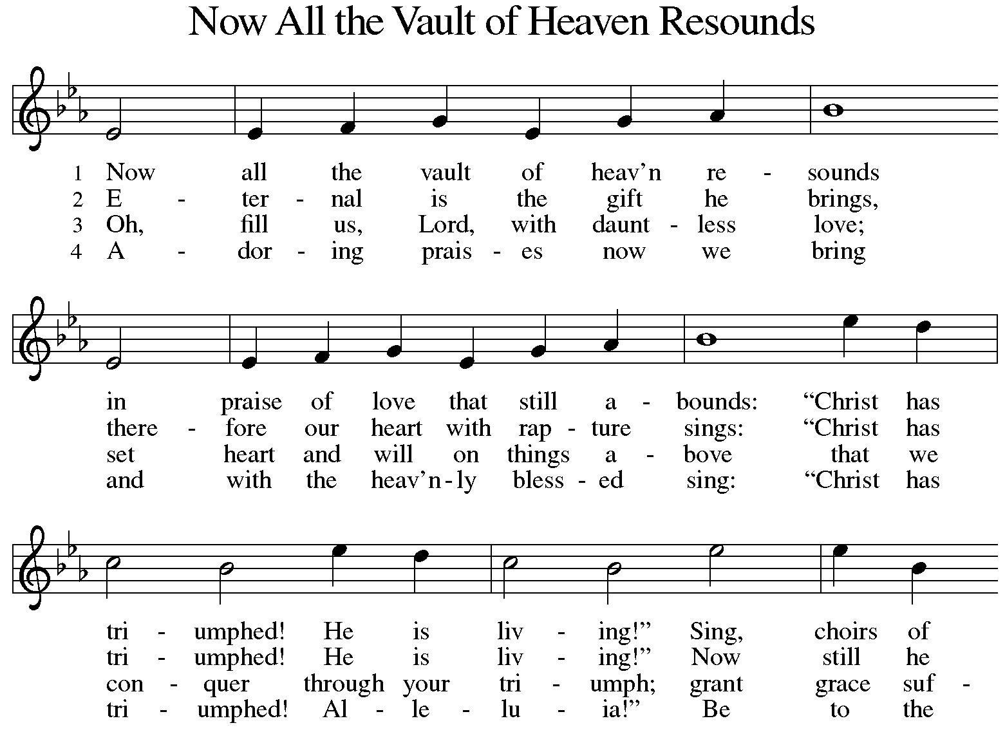
ELW #367

Slide 76
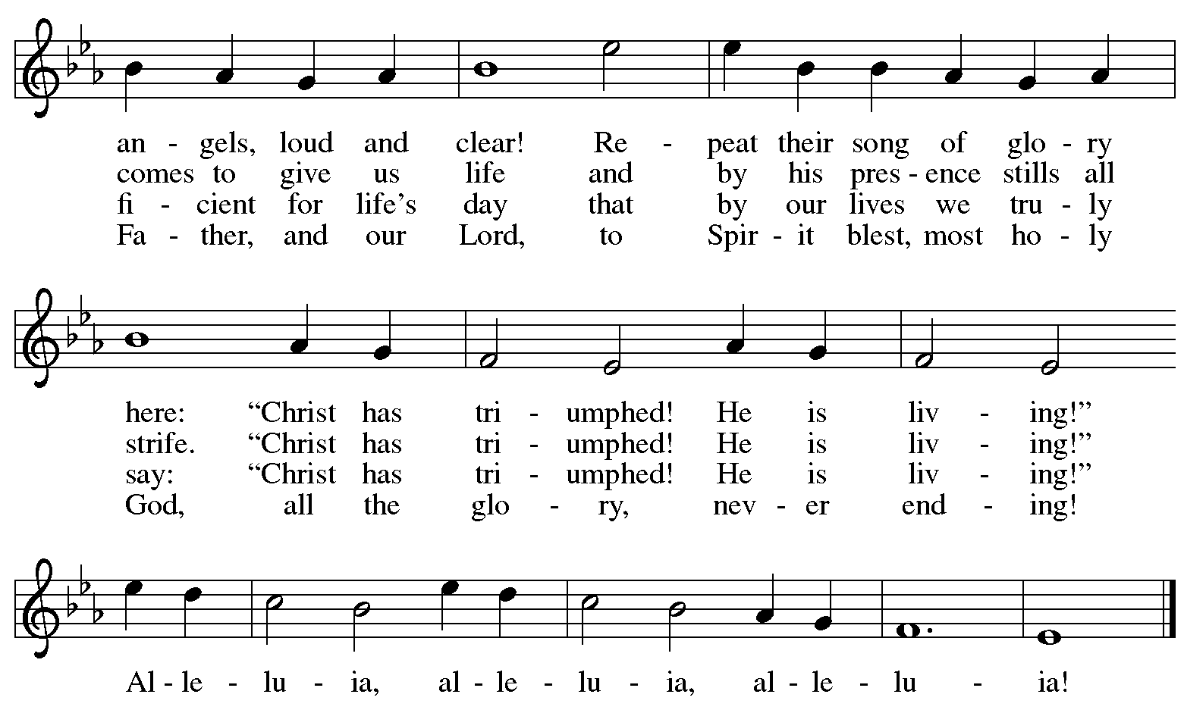

Slide 77
ELW #367

Slide 79
ELW #367

Slide 81
ELW #367

Slide 84
ELW #167
Now The Feast and Celebration

Slide 86
Now The Feast and Celebration

Slide 88
Now The Feast and Celebration

Slide 90
Now The Feast and Celebration

Slide 92
ELW #384

Slide 94
ELW #377

Slide 95
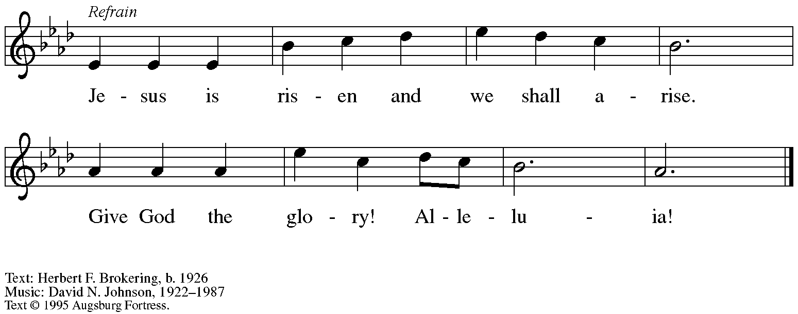

Slide 105
ELW #380

Slide 106
4 Jesus lives! Let all rejoice.
Praise him, ransomed of the earth.
Praise him in a nobler song,
cherubim of heav’nly birth.
Praise the victor king, whose sway
sin and death and hell obey.
5 Hallelujah! Angels, sing!
Join with us in hymns of praise.
Let your chorus swell the strain
which our feebler voices raise:
Glory to our God above
and on earth his peace and love!
Text: Carl B. Garve, 1763-1841; tr. Jane Borthwick, 1813-1897, alt.

Slide 108
Weekend April 18 & 19

Slide 109
ELW #385

Slide 111
ELW #366

Slide 113
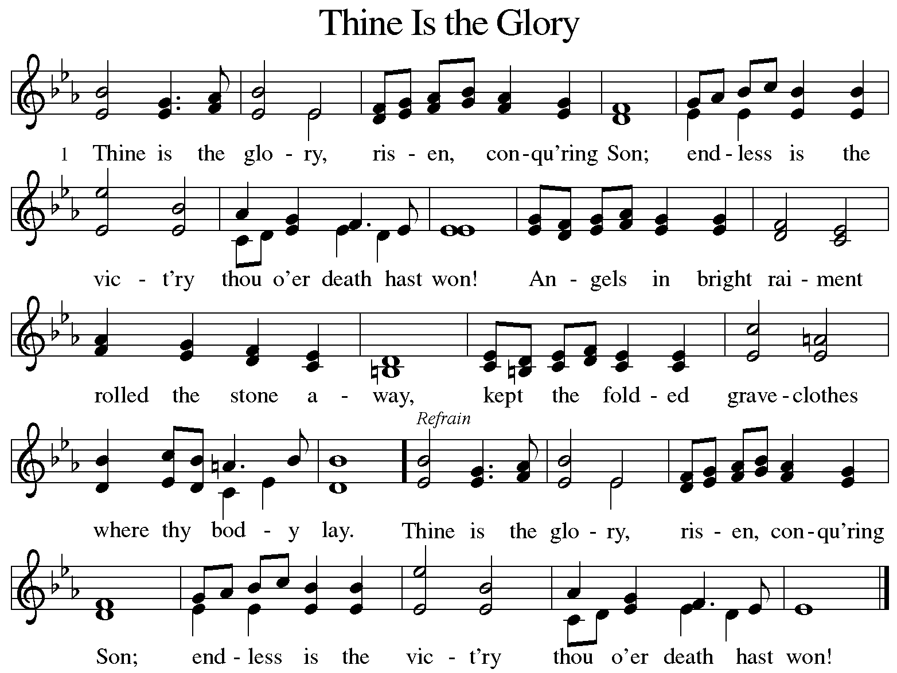
ELW #376

Slide 114
2 Lo, Jesus meets thee,
risen from the tomb!
Lovingly he greets thee,
scatters fear and gloom;
let his church with gladness
hymns of triumph sing,
for the Lord now liveth;
death hath lost its sting! Refrain
Refrain
Thine is the glory,
risen, conqu'ring Son;
endless is the vict'ry
thou o'er death hast won!

Slide 115
3 No more we doubt thee,
glorious Prince of life;
life is naught without thee;
aid us in our strife;
make us more than conqu'rors,
through thy deathless love;
bring us safe through Jordan
to thy home above. Refrain
Refrain
Thine is the glory,
risen, conqu'ring Son;
endless is the vict'ry
thou o'er death hast won!
Text: Edmond Budry, 1854-1932; tr. R. Birch Hoyle, 1875-1939

Slide 118
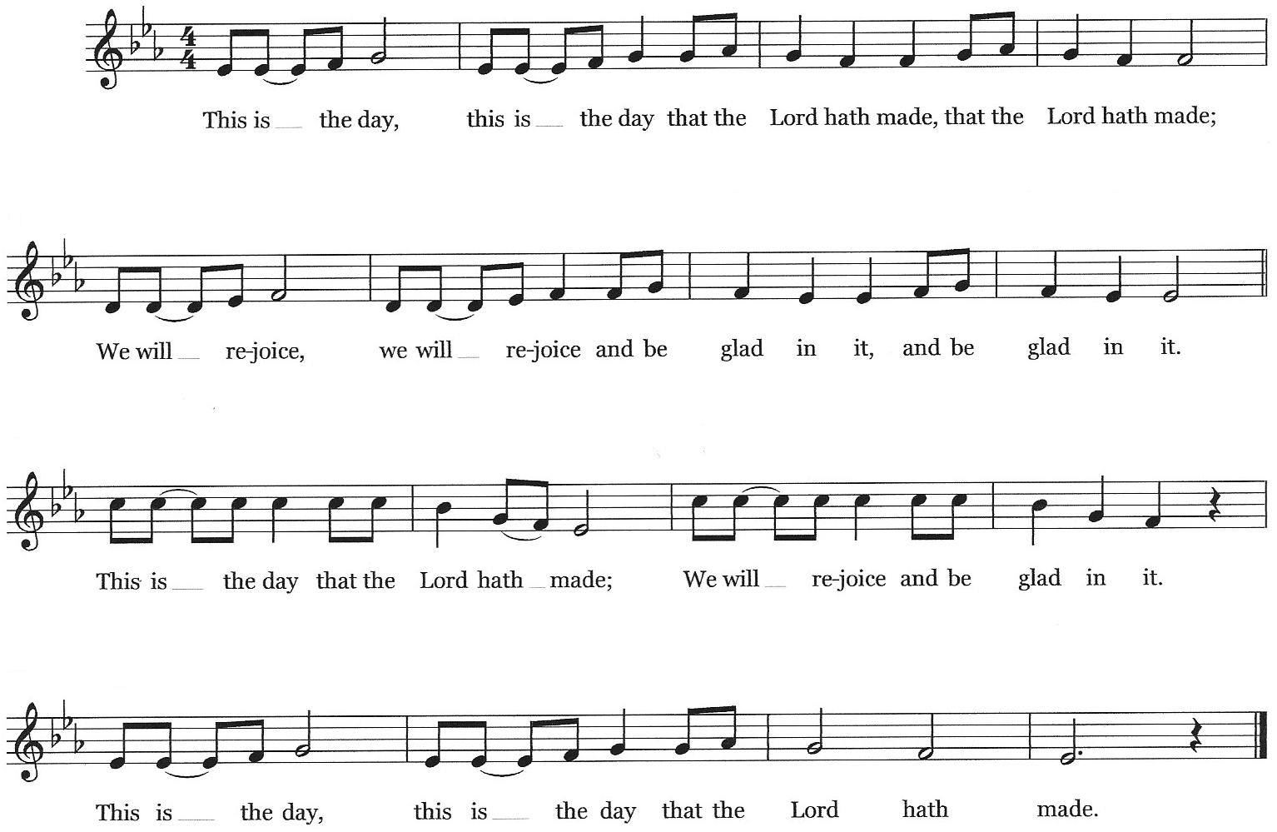
This Is The Day

Slide 119
This Is the Day
This is the day, this is the day
that the Lord has made, that the Lord has made;
we will rejoice, we will rejoice
and be glad in it, and be glad in it.
This is the day that the Lord has made;
we will rejoice and be glad in it.
This is the day, this the day that the Lord has made.
Text: Psalm 118:24

Slide 122
Joy
I’ve got the Joy, (joy), joy, (joy), joy,( joy)
I’ve got the joy, (joy), joy, (joy), joy,(joy)
I’ve got the joy, (joy), joy, (joy), joy…….
Down in my heart, down in my heart,
Down in my heart to stay down in my heart to stay.
2. Love….3.light…4. joy…….

Slide 128
ELW #556

Slide 129
3 Mine is the sunlight! Mine is the morning,
born of the one light Eden saw play!
Praise with elation, praise ev’ry morning,
God’s recreation of the new day!
Text: Eleanor Farjeon
© David Higham Associates, Ltd.

Slide 131
ELW # 677

Slide 132
3 Jesus gave it to me, I'm goin'-a let it shine;
Jesus gave it to me, I'm goin'-a let it shine;
Jesus gave it to me, I'm goin'-a let it shine,
let it shine, let it shine, let it shine.
Text: African American spiritual

Slide 134
ELW #543

Slide 135
ELW #543

Slide 136
ELW #543

Slide 138
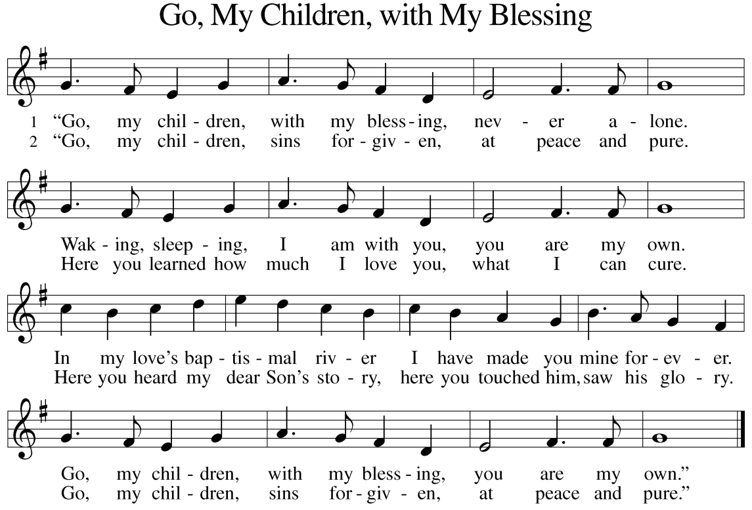
WOV #721

Slide 139
3 “Go, my children, fed and nourished, closer to me.
Grow in love and love by serving, joyful and free.
Here my Spirit’s power filled you,
here his tender comfort stilled you.
Go, my children, fed and nourished, joyful and free.
4 “I the Lord will bless and keep you, and give you peace.
I the Lord will smile upon you, and give you peace.
I the Lord will be your Father,
Savior, Comforter and Brother.
Go, my children, I will keep you, and give you peace.”
Text: Jaroslav J. Vajda, b. 1919

Slide 144
Weekend April 25 & 26

